Slide 1
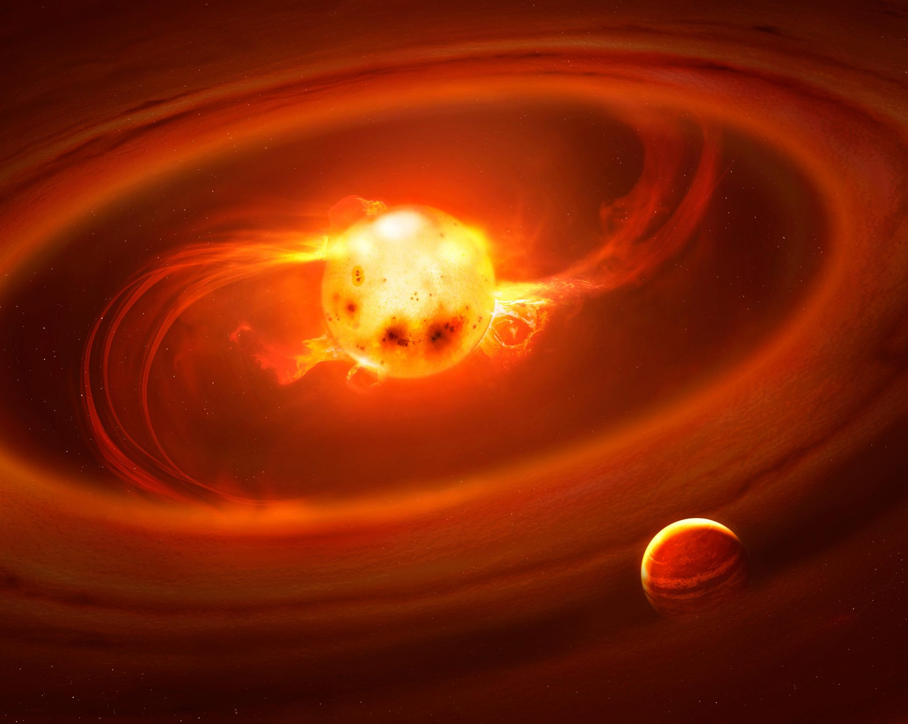


Colors of YSO variability
Dynamical signatures of young stars and their planet-forming disks across the wavelength spectrum
Laura Venuti
Research Scientist, SETI Institute, CA, USA
Image credit: Mark A. Garlick

Slide 2
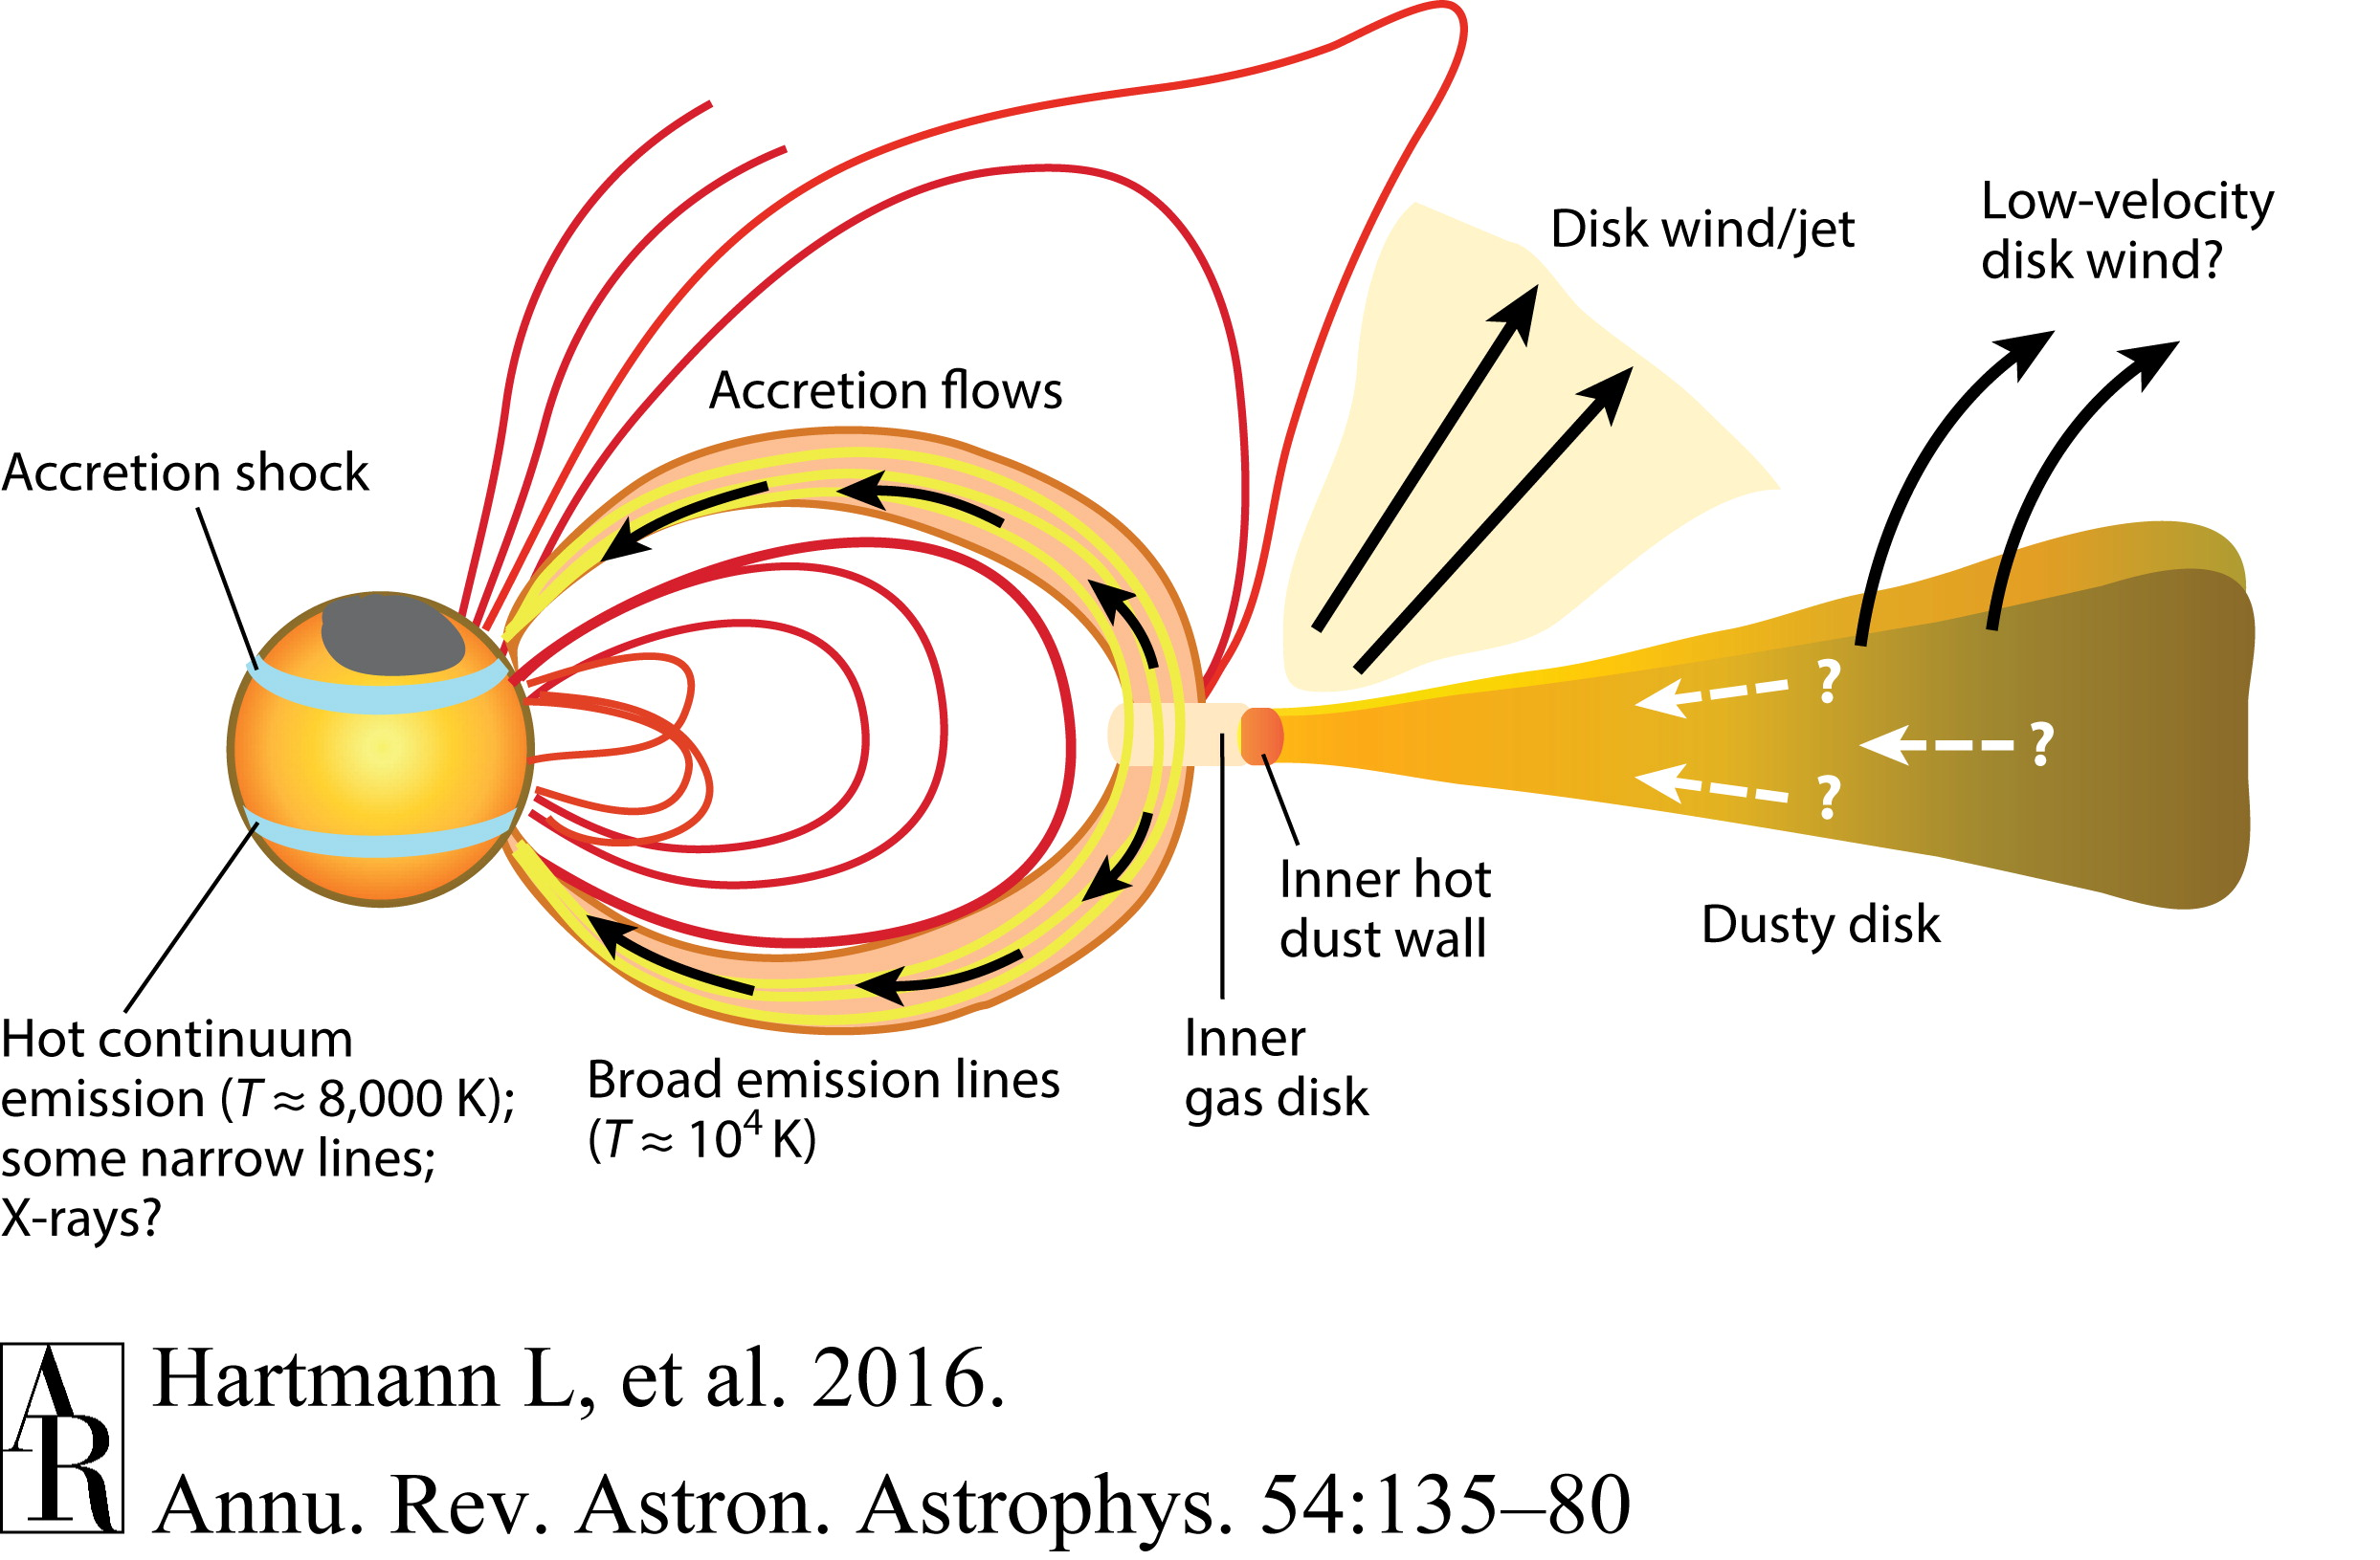
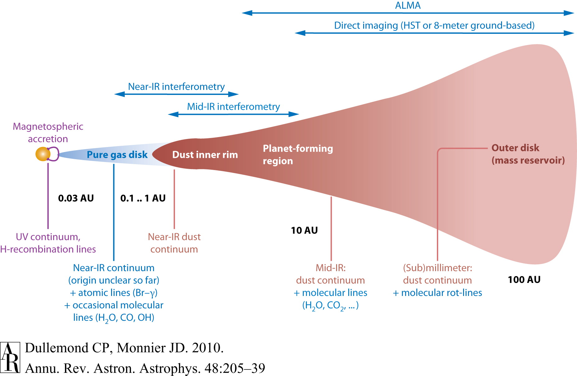
A schematic view of young star-disk systems
The star and the inner disk interact via the stellar magnetosphere
Dynamics of star-disk interaction is regulated via mass accretion process
Distinct inner disk processes leave an imprint at distinct wavelengths
Multi-wavelength observations
probing of separate emission components: star surface emission (optical); accretion shock emission (ultraviolet); thermal emission from the disk (near-infrared)

Slide 3
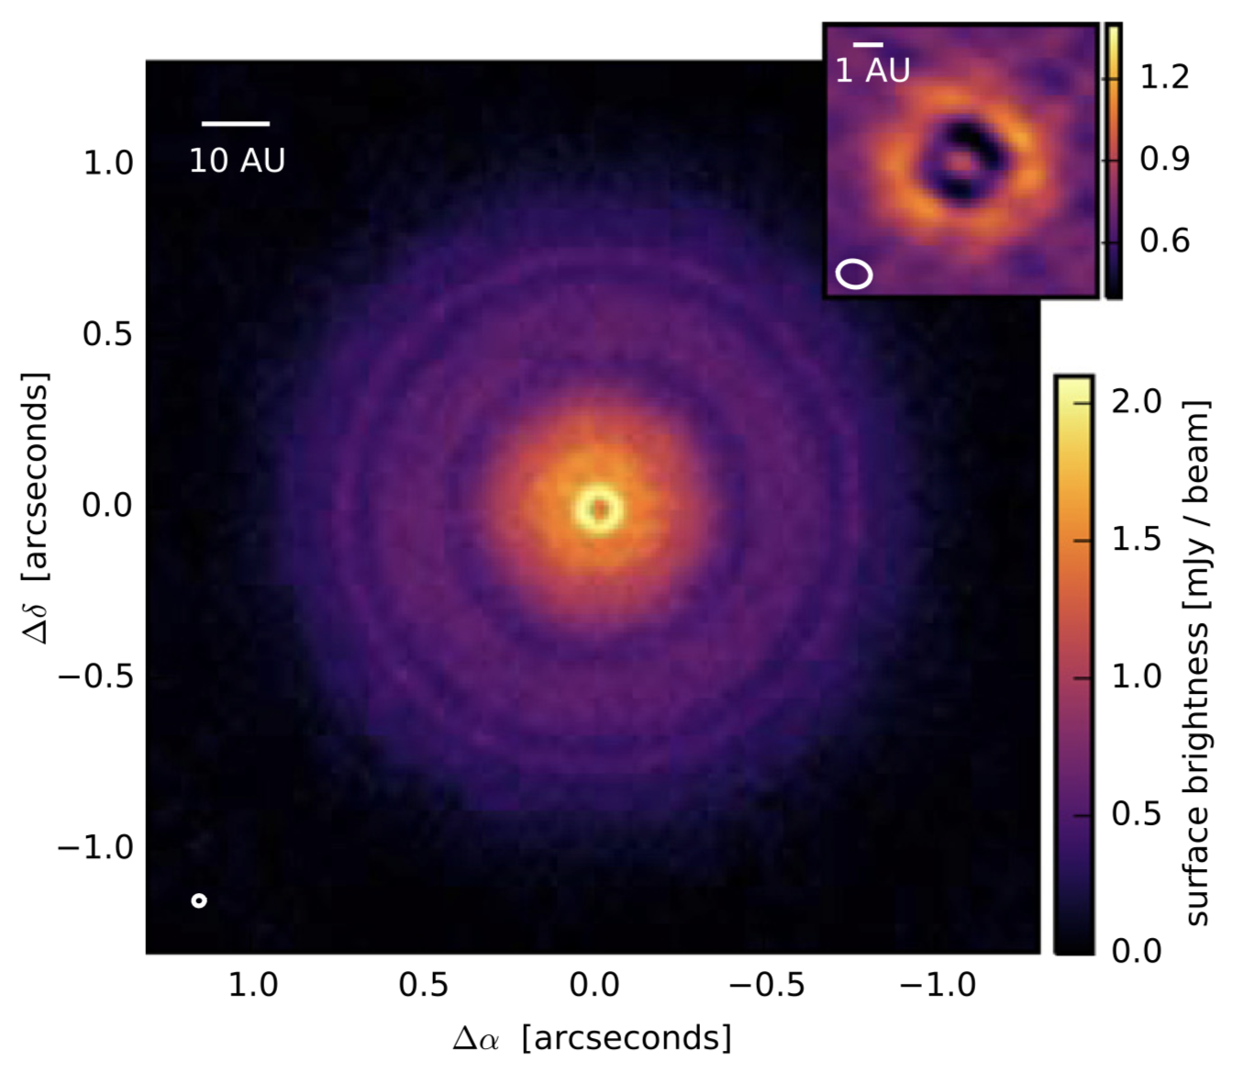
The young star–inner disk environment
Andrews et al. 2016, ApJL 820
Spatial scales relevant to star-disk interaction are hardly to access via direct imaging
TW Hya (d = 60 pc)
Three-pronged strategy to study the inner disk processes:
reconstruct the star-disk emission spectrum;
monitor the variability of star-disk luminosity;
observe large samples of coeval stars in young clusters.

Slide 4
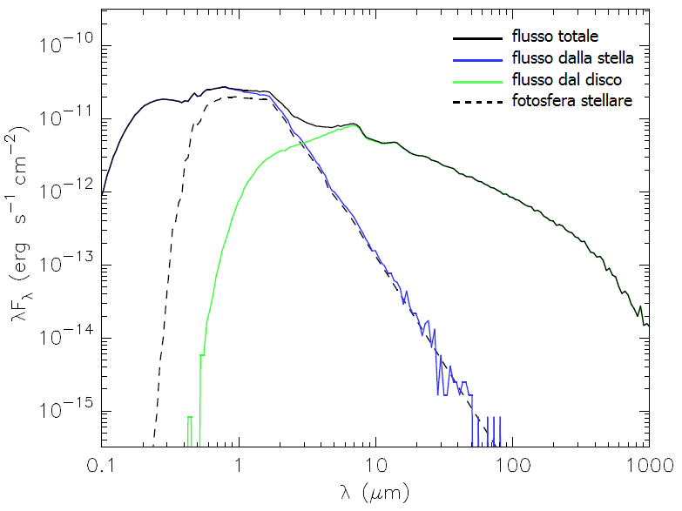
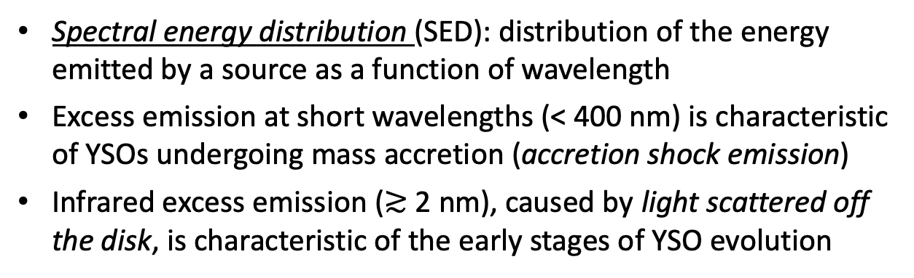
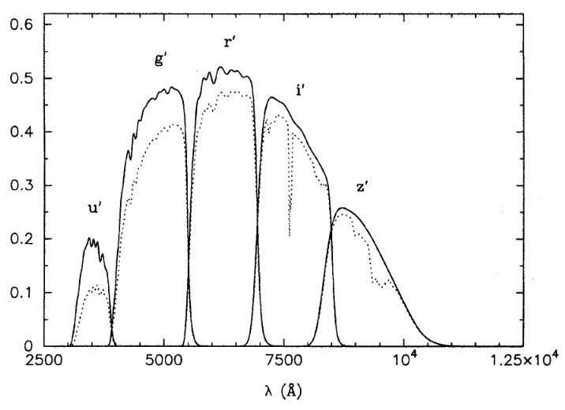
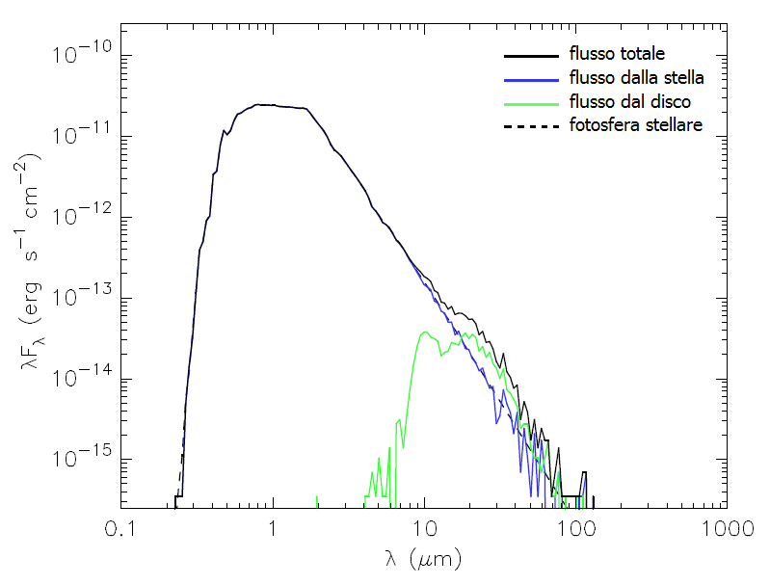
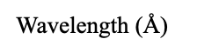
Spectral energy distributions of young stars
Total flux
Stellar flux
Disk flux
Photosphere
Synthetic SED for a young accreting star
r-band
630 nm
g-band
480 nm
Multi-color photometric system:
Stellar flux measured in selective wavelength bands
Filters in the visible (g,r,i) trace intrinsic star properties (temperature T_{eff}, mass M★)
UV filters trace disk accretion
Total flux
Stellar flux
Disk flux
Photosphere
i-band
770 nm
Robitaille et al. (2006), ApJS 167, 256
Response function
u-band
360 nm
Synthetic SED for a
young non-accreting star
Fukugita et al. (1996), AJ 111, 1748

Slide 5
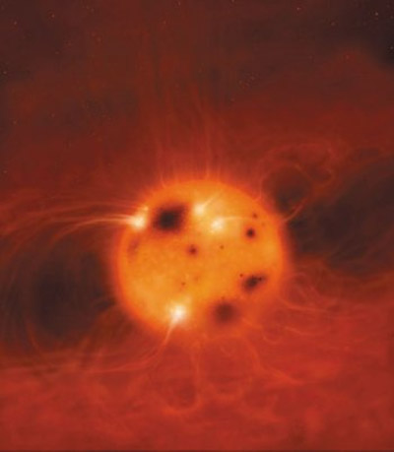
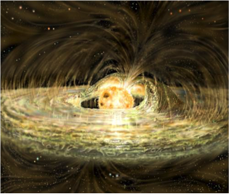
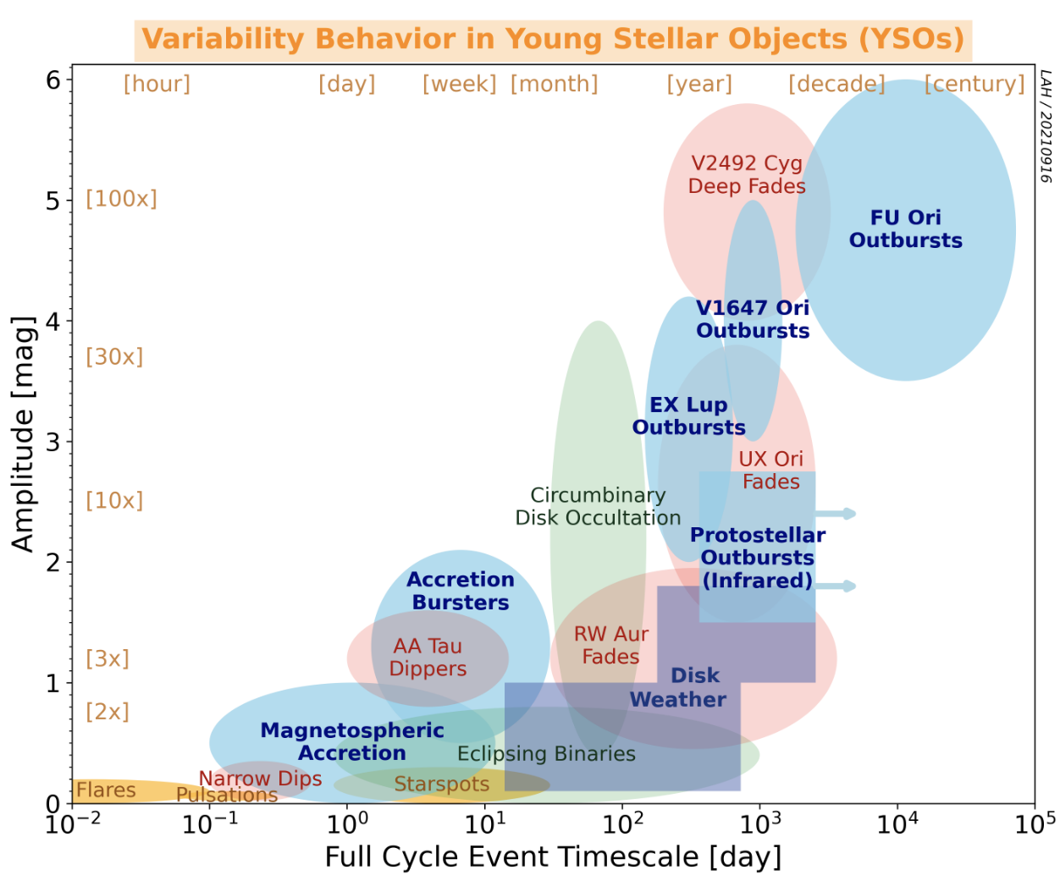
The photometric variability of young stars
Young stars are intrinsically variable at all wavelengths and on any given timescale from hours to decades.
The typically predominant variability is that observed over timescales of days to weeks (corresponding to the stellar rotational timescales).
Credit: Mark Garlick
Artist’s impressions of the surface of a young star (left) and of a young star accreting from the circumstellar disk (right).
Causes for day-to-week variability in young stars:
Magnetic activity -> flux modulation by starspots (analogous to dark spots found on the Sun)
Star–disk interaction -> variable emission from accretion shocks and variable accretion
Star–disk geometry -> varying visibility of different structures of the star-inner disk environment
All abovementioned effects are typically blended in the specific variability behavior for a given star
Fischer et al. (2022), Protostars and Planets VII

Slide 6
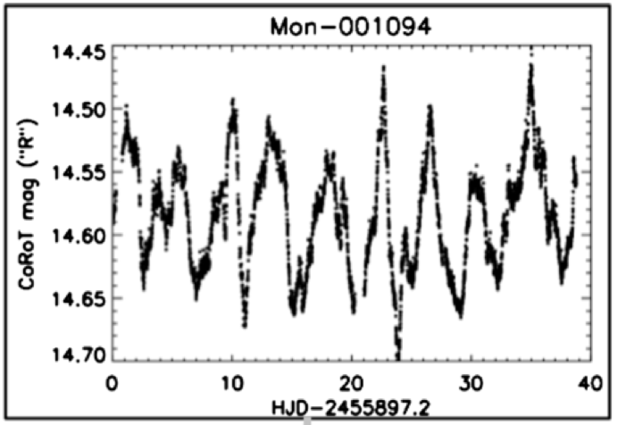
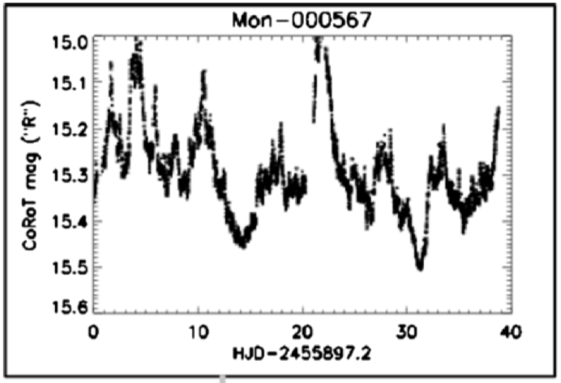
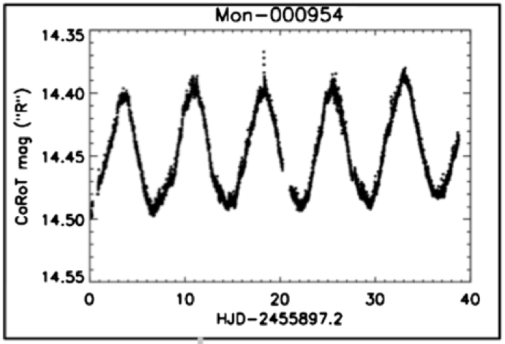
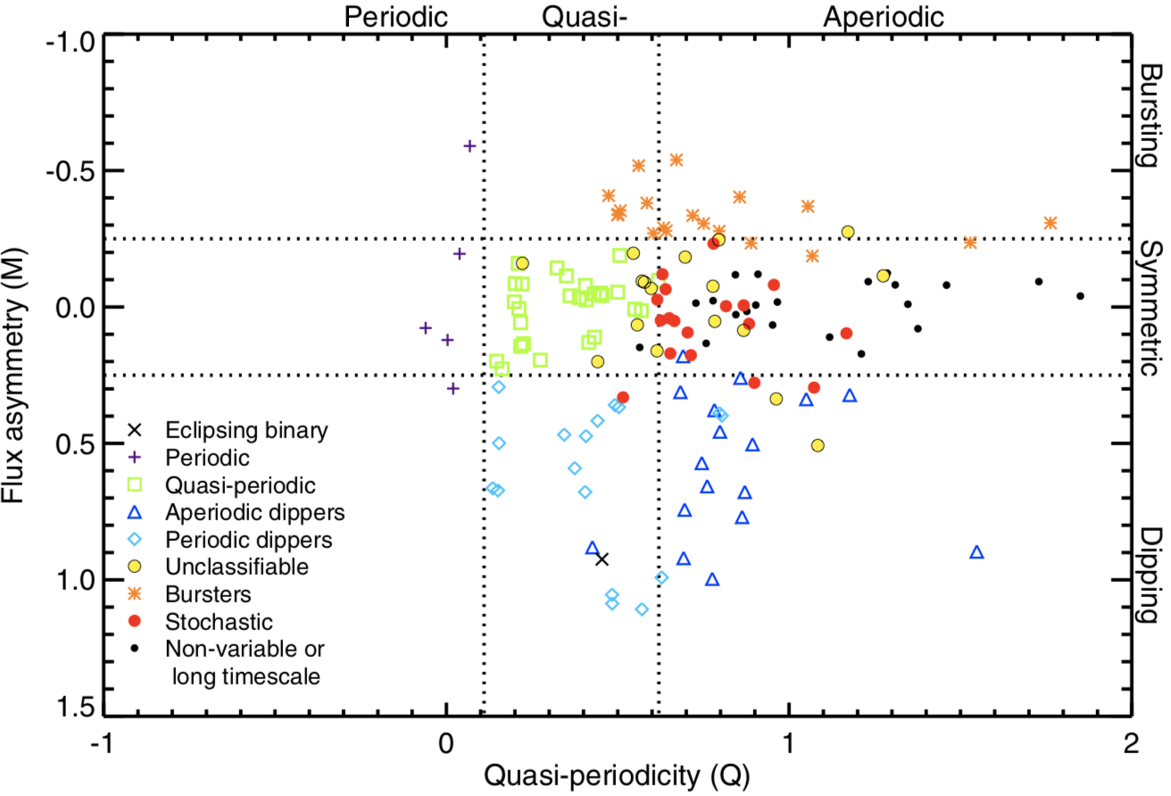
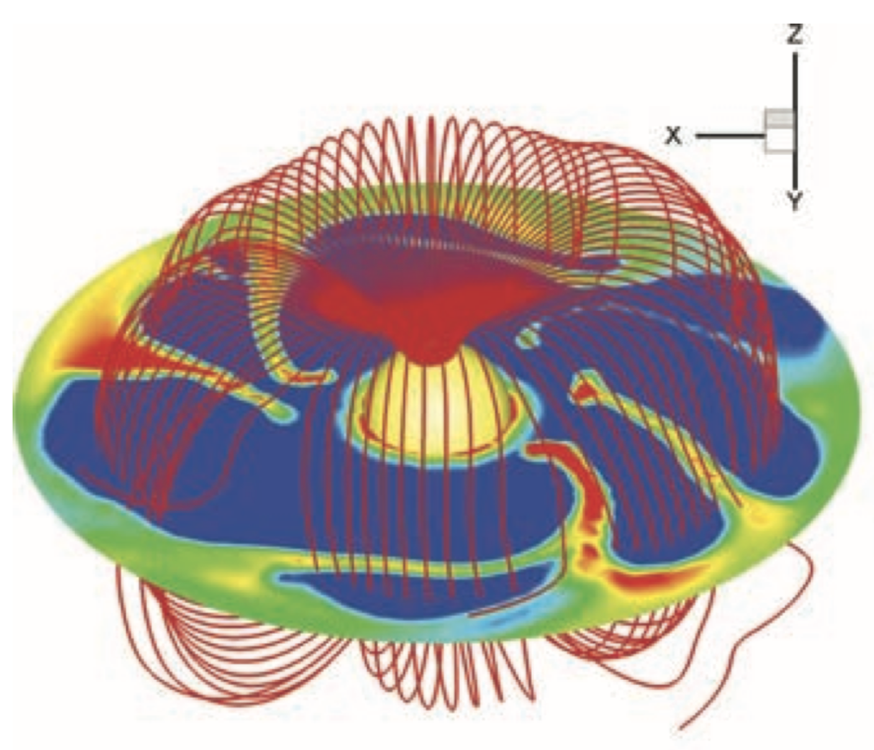
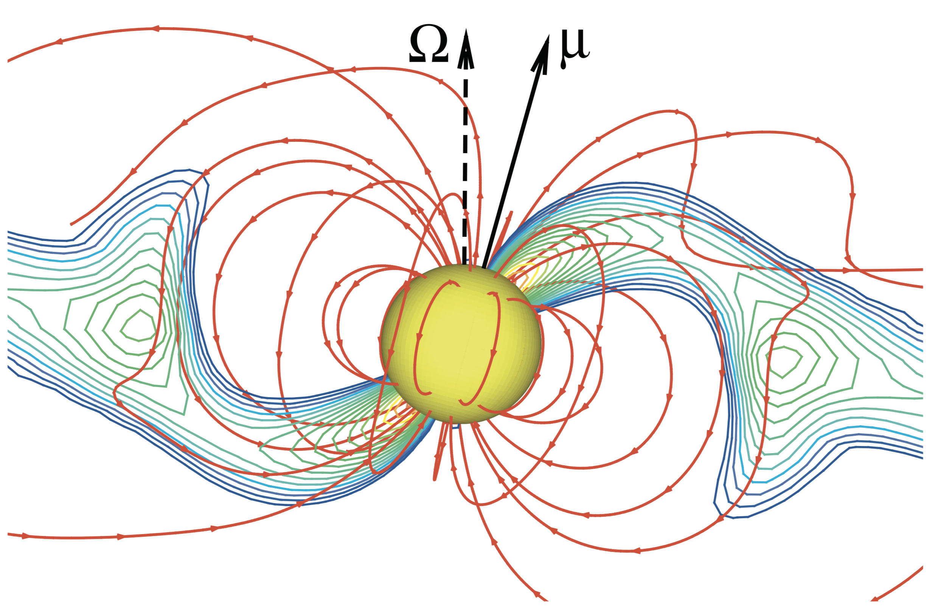
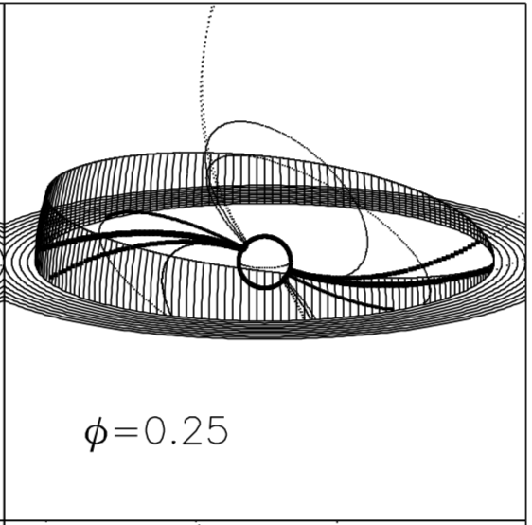
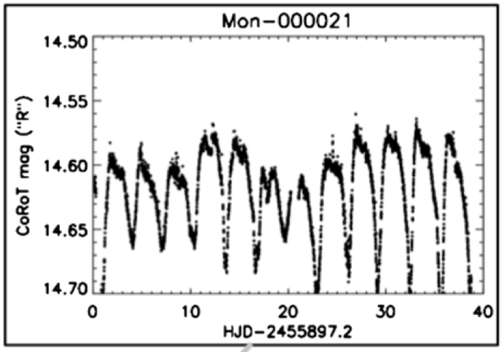
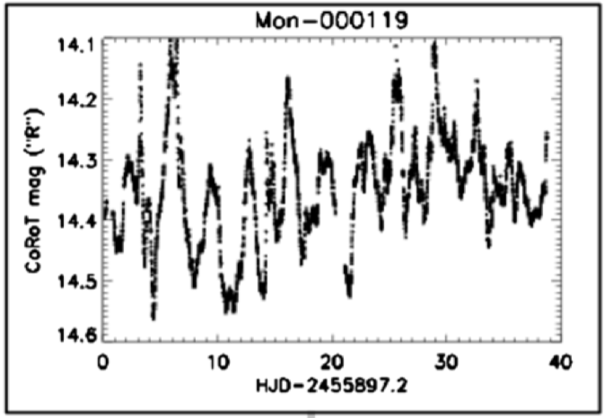
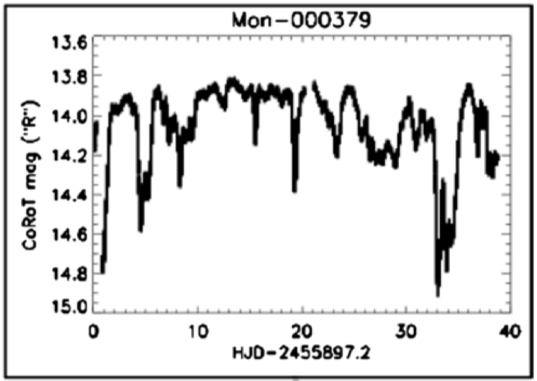
Manifold variability behaviors of young stars with disks
Cody et al. 2014, AJ 147
Optical monitoring of young stars from space:
CoRoT (Coordinated Synoptic Investigation of NGC 2264) [Cody et al. 2014]
Kepler/K2 (Upper Sco, ρ Oph, Lagoon Nebula) [Cody & Hillenbrand 2018, AJ 156; Venuti et al. 2021, AJ 162]
Kulkarni & Romanova 2008, MNRAS 386, 673
Romanova et al. 2004, ApJ 610, 920
Bouvier et al. 1999, A&A 349, 619
Over eight distinct categories of variability statistically identified from space

Slide 7
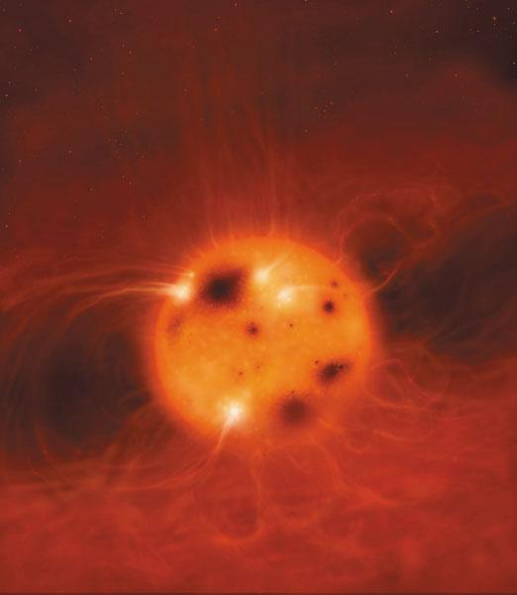
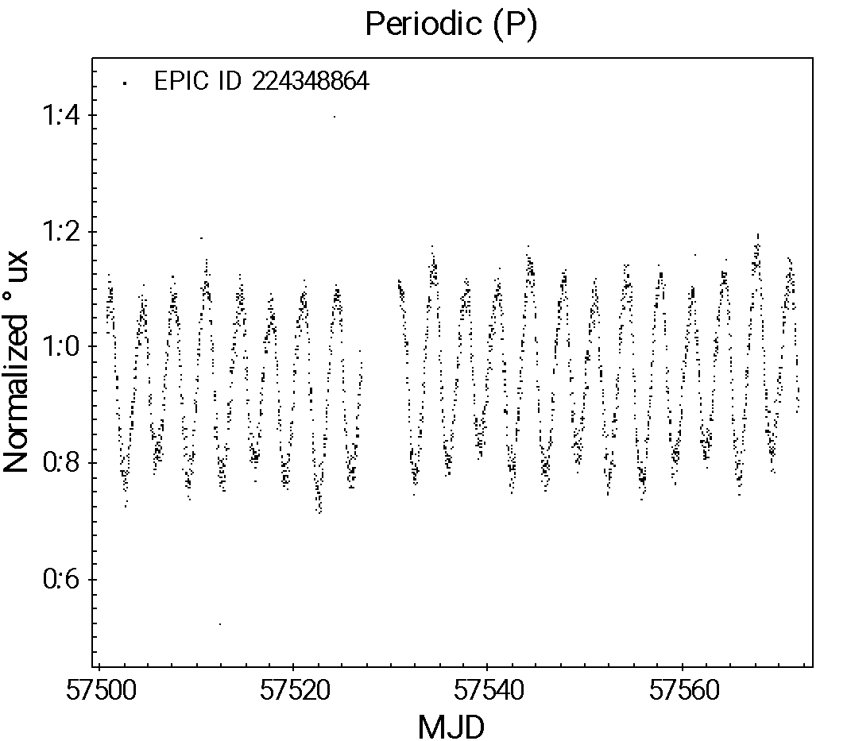
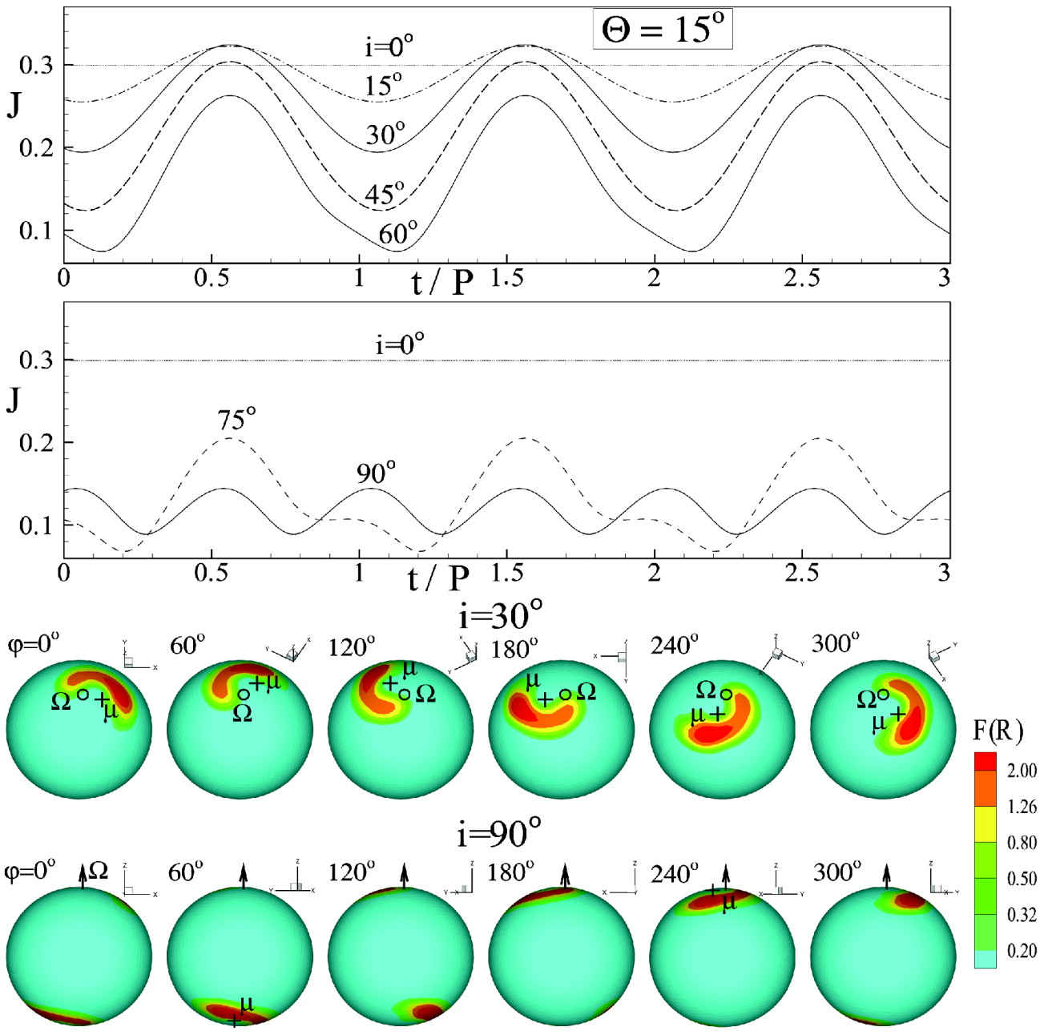
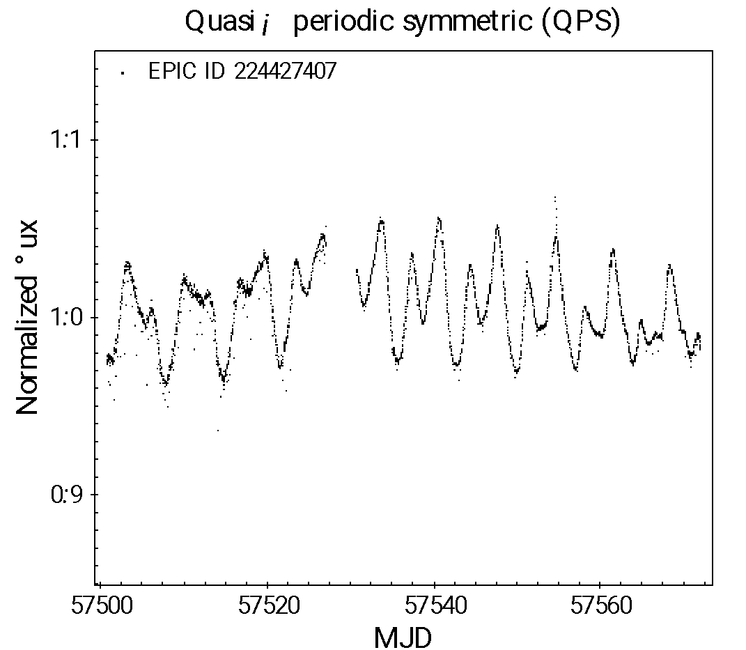
The origin of modulated variability in young stars
Credit: Mark Garlick
Up to 40% of young stellar surface covered by spots
Dark spots -> magnetic; bright spots -> accretion
Luminosity modulation by spots during star rotation
Periodicity of modulation indicates stellar spin rate
Amplitude of modulation is a proxy for spot distribution and magnetic field structure
Intensity of radiation
Credit: Mark Garlick
Periodic
Time (days)
Quasi-periodic
Time (days)
Romanova et al. (2004), ApJ, 610, 920

Slide 8
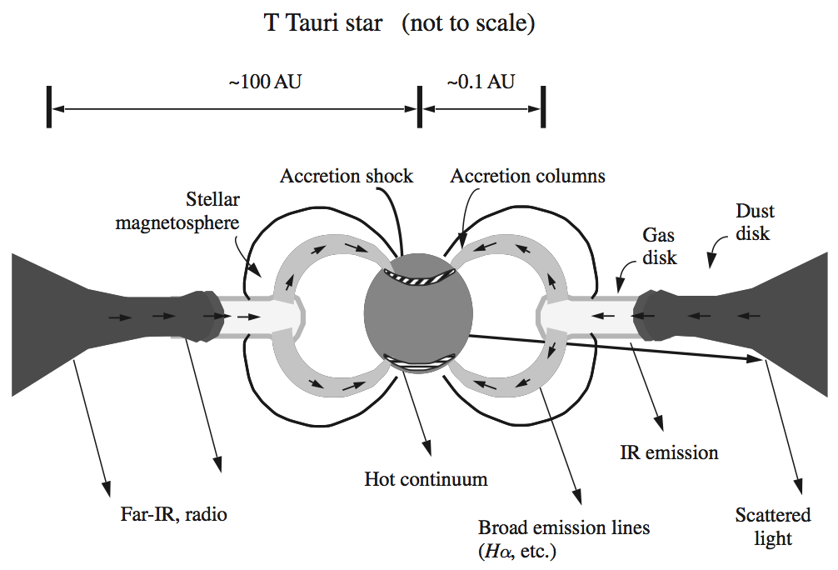
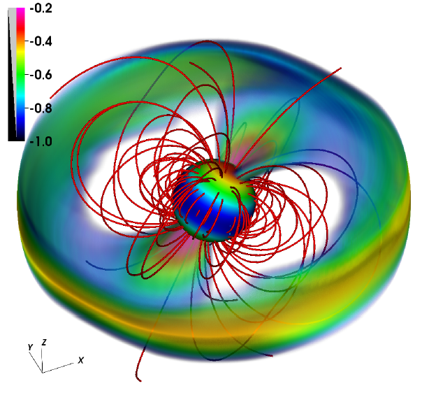
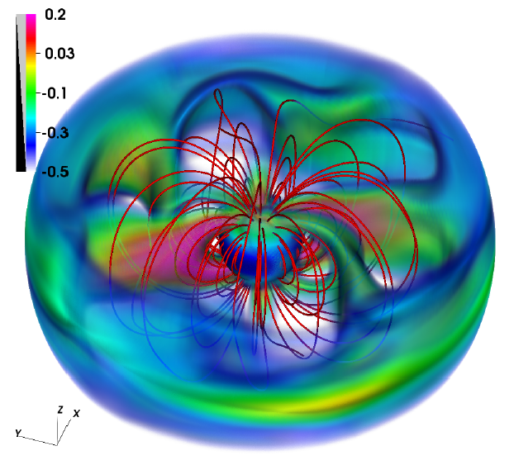
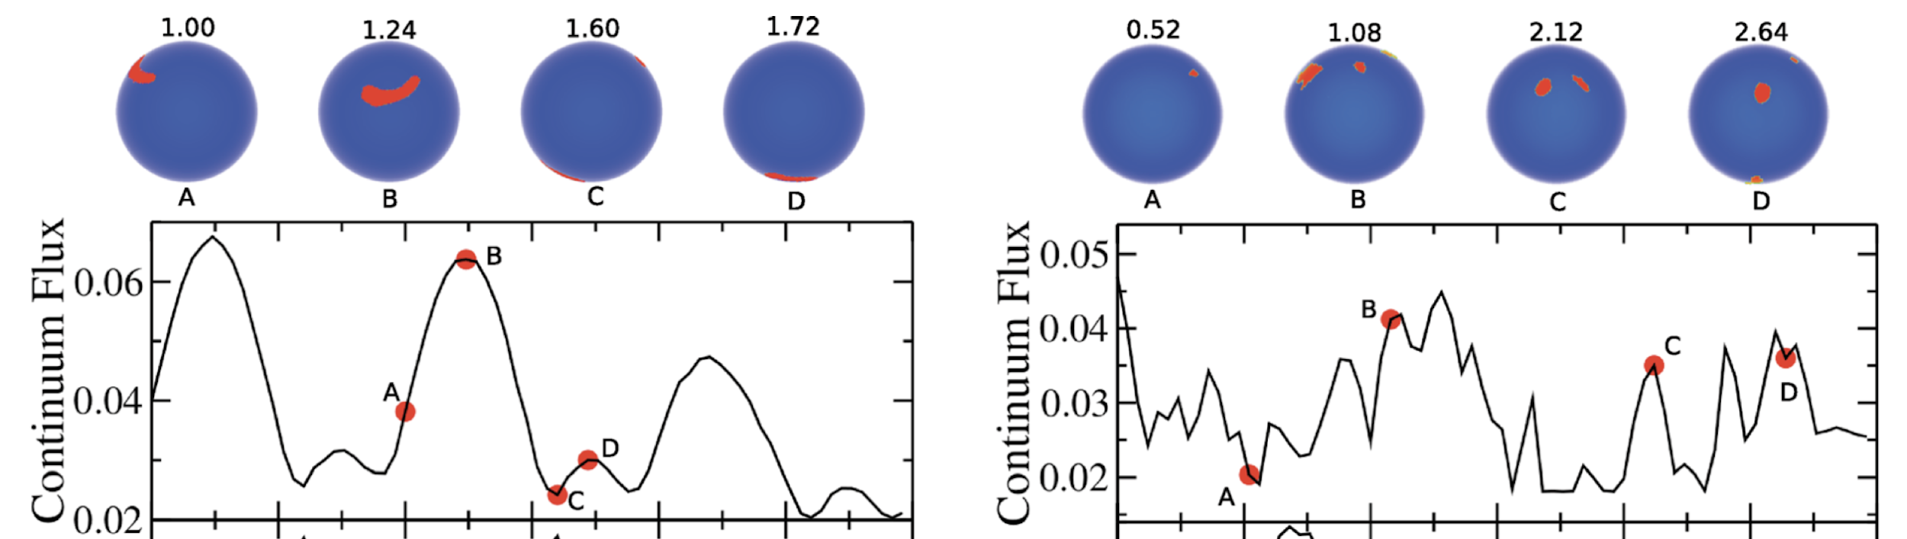
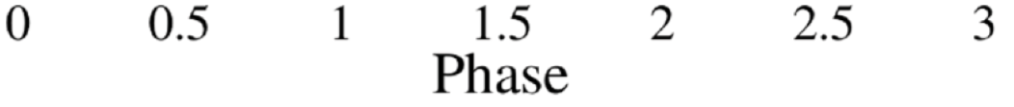
Paradigms of disk accretion in young stars
Hartmann (2009), Accretion Processes in Star Formation
Kurosawa & Romanova (2013), MNRAS 431, 2673
Axisymmetric
Steady regime
Non-axisymmetric
Steady regime
Non-axisymmetric
Unsteady regime
Predicted light curves:
Globally periodic on rotation timescales (steady regime)
Irregular short-term luminosity variations (unsteady regime)

Slide 9
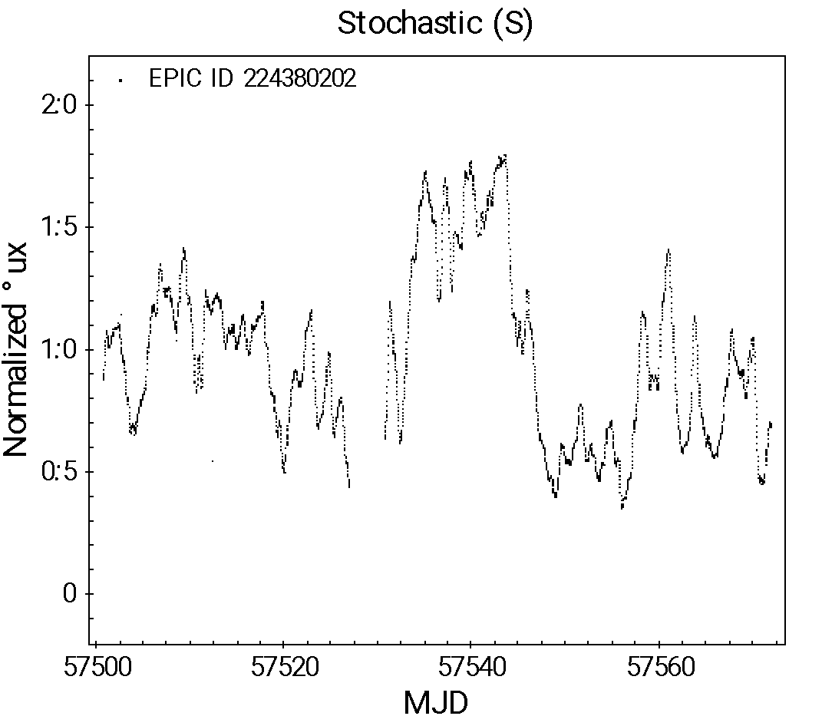
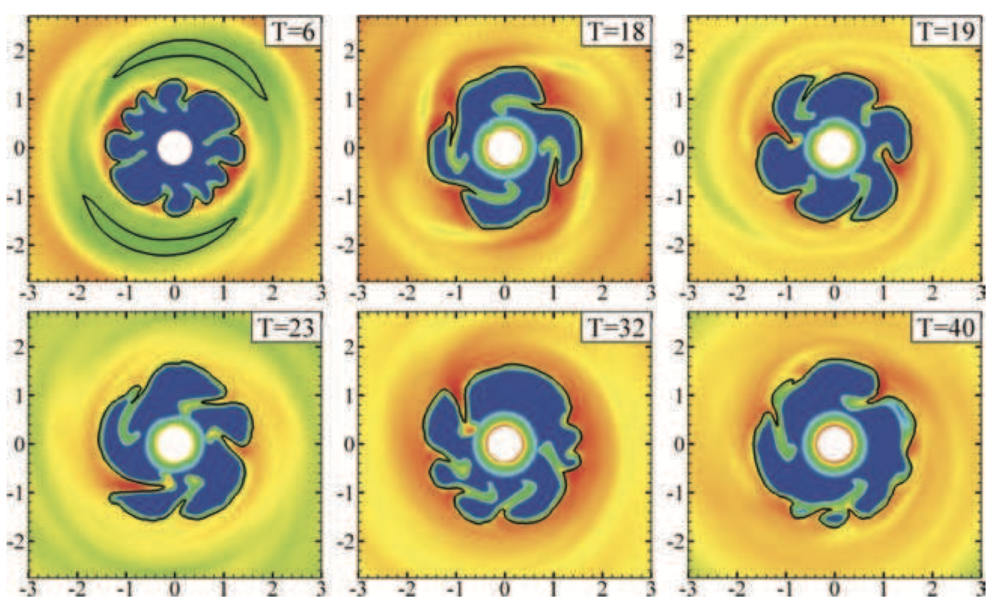
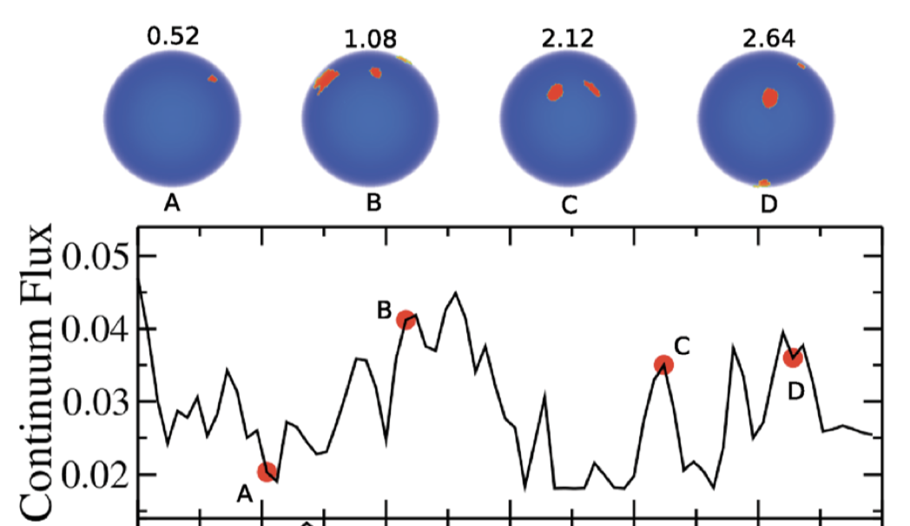
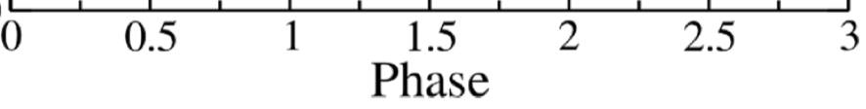
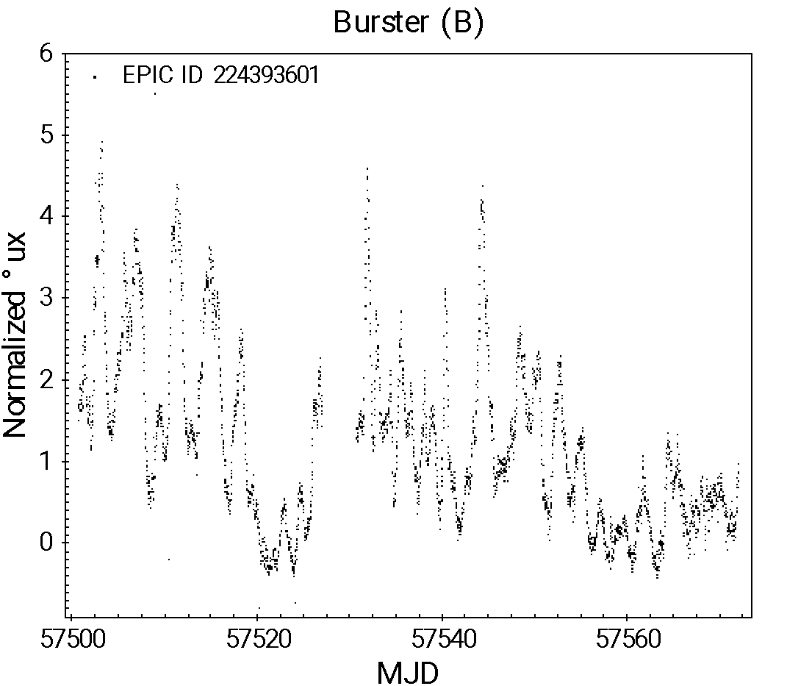
The origin of erratic variability in young stars
Stochastic
Time (days)
Kulkarni and Romanova (2008), MNRAS 386, 673: Simulation of unstable mass accretion from the inner disk onto the star, seen perpendicularly to the disk plane. The number and location of accretion streams changes chaotically with time.
Kurosawa and Romanova (2013), MNRAS 431, 2673: Simulated time-variable distribution of surface accretion shocks at different rotational phases, and resulting light curve for a young star undergoing unstable accretion.
Time behavior dominated by accretion shocks
Star-disk interaction is unstable -> bright spot morphology changes on timescales shorter than the rotation rate of the star
Bursting
Time (days)

Slide 10
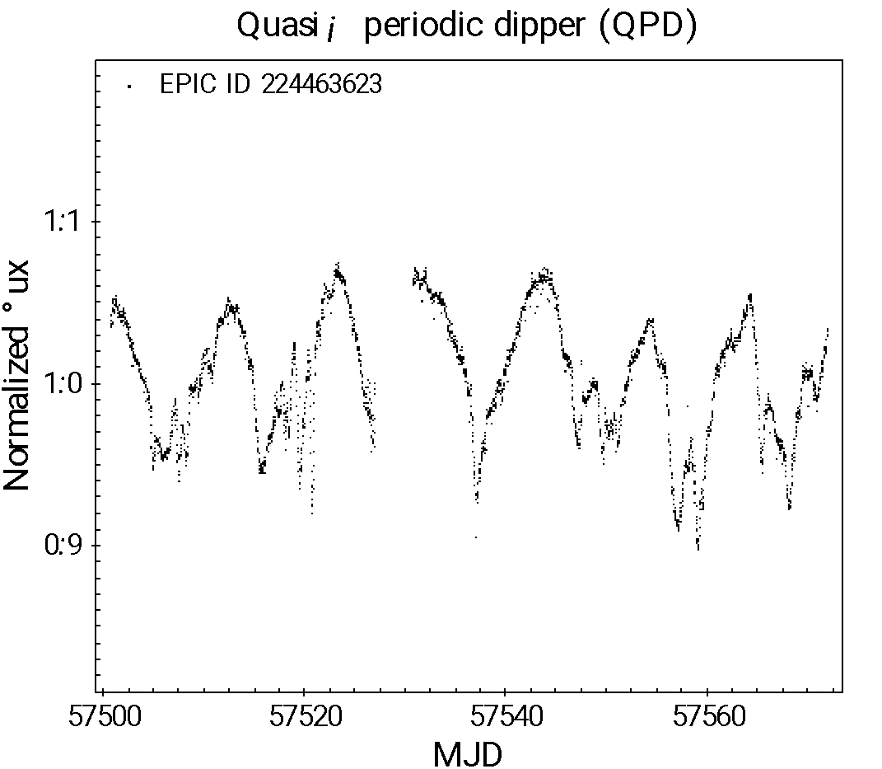
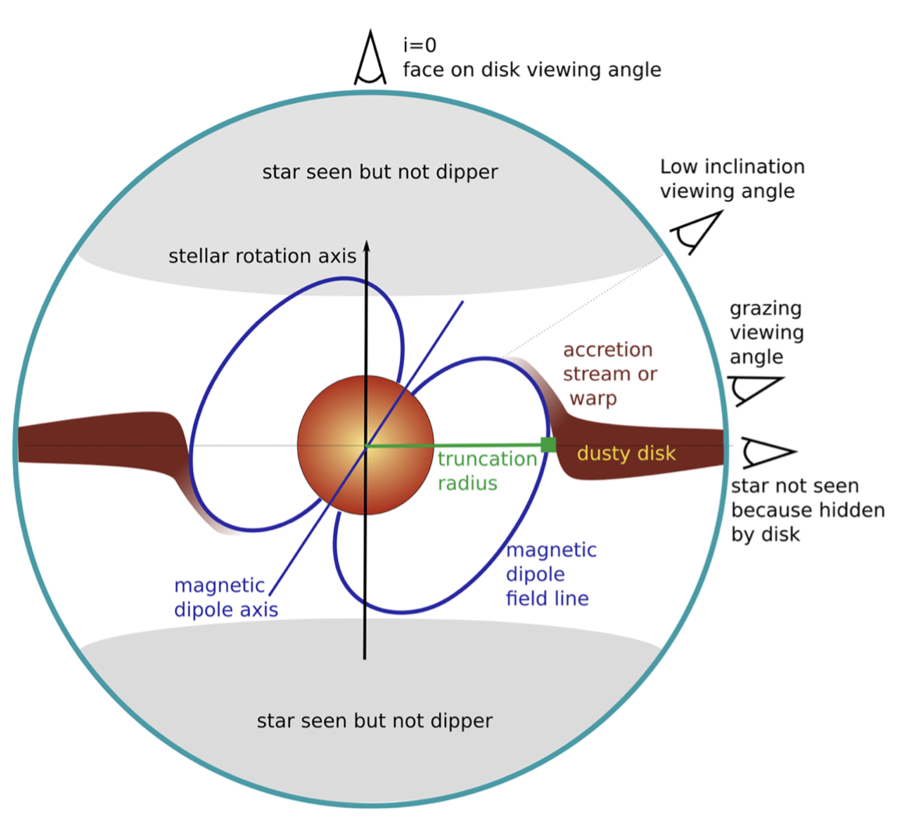
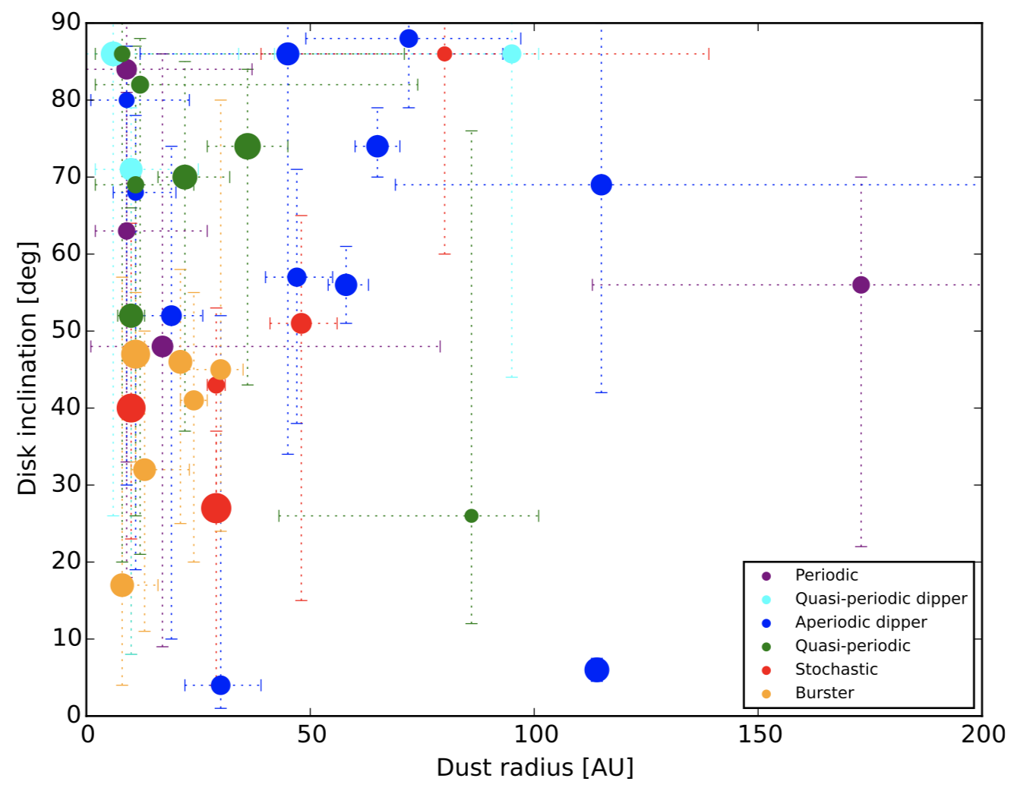
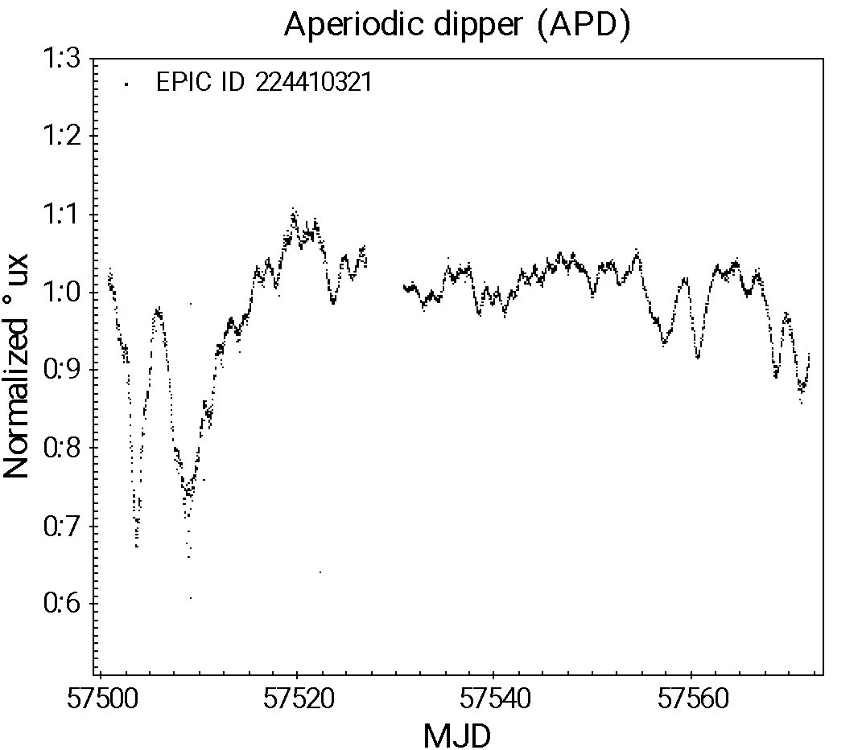
The origin of dipping variability in young stars
edge-on
Cody & Hillenbrand (2018), AJ 156, 71
Disk inclination (deg)
Dipping (quasi-periodic)
Kepler/K2 + ALMA data
Time (days)
face-on
Bodman et al. (2017), MNRAS 470, 202
Dust radius (AU)
Inner disk warped at the base of the accretion columns
For nearly edge-on viewing angles (line-of-sight to the star grazing the disk plane), time behavior dominated by recurring disk occultations of the star; the same star could exhibit modulated variability if seen at lower inclinations!
Dipping (aperiodic)
Flux dips quasi-periodic if star-disk interaction is stable, aperiodic otherwise
Time (days)

Slide 11
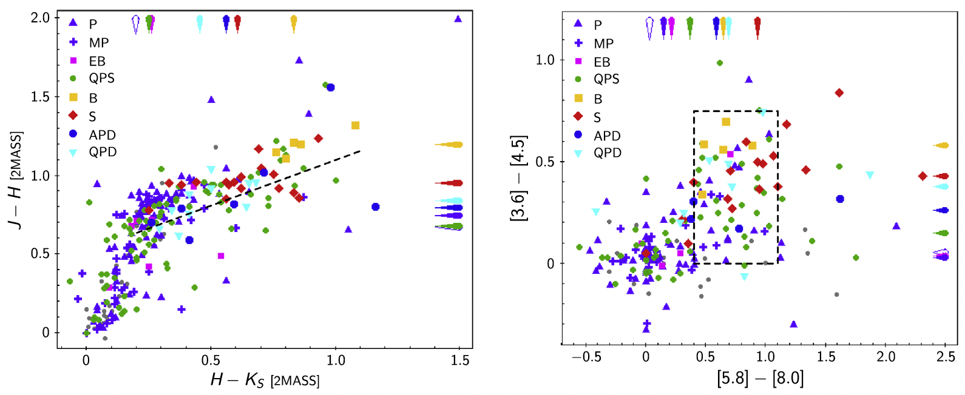
Connecting variability and color properties in YSOs
J,H,K bands: near-IR from 1.2-2.2 μm
Spitzer/IRAC: mid-IR from 3.6 to 8 μm
These colors trace reprocessed light from dust located between 0.1-5 AU away from the star
Venuti et al. (2021), AJ 162, 101
Modulated variability behaviors associated with nearly photospheric IR colors (more evolved disks)
Dipping behaviors associated with more conspicuous IR emission than modulated behaviors
Erratic behaviors associated with strong IR excesses compared to photospheric levels (dusty disks)
Stochastic and bursting behaviors may be triggered in different regions of the disk

Slide 12
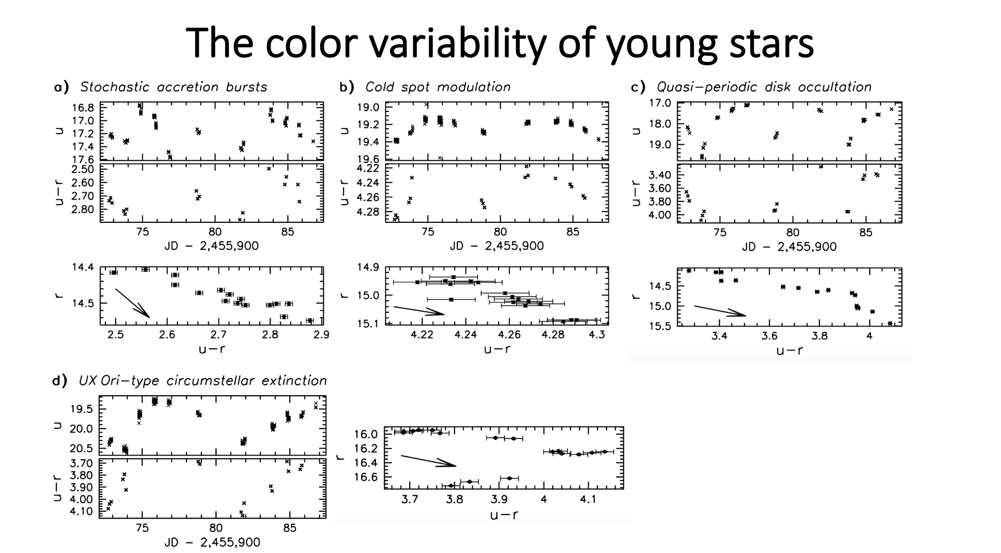

Slide 13
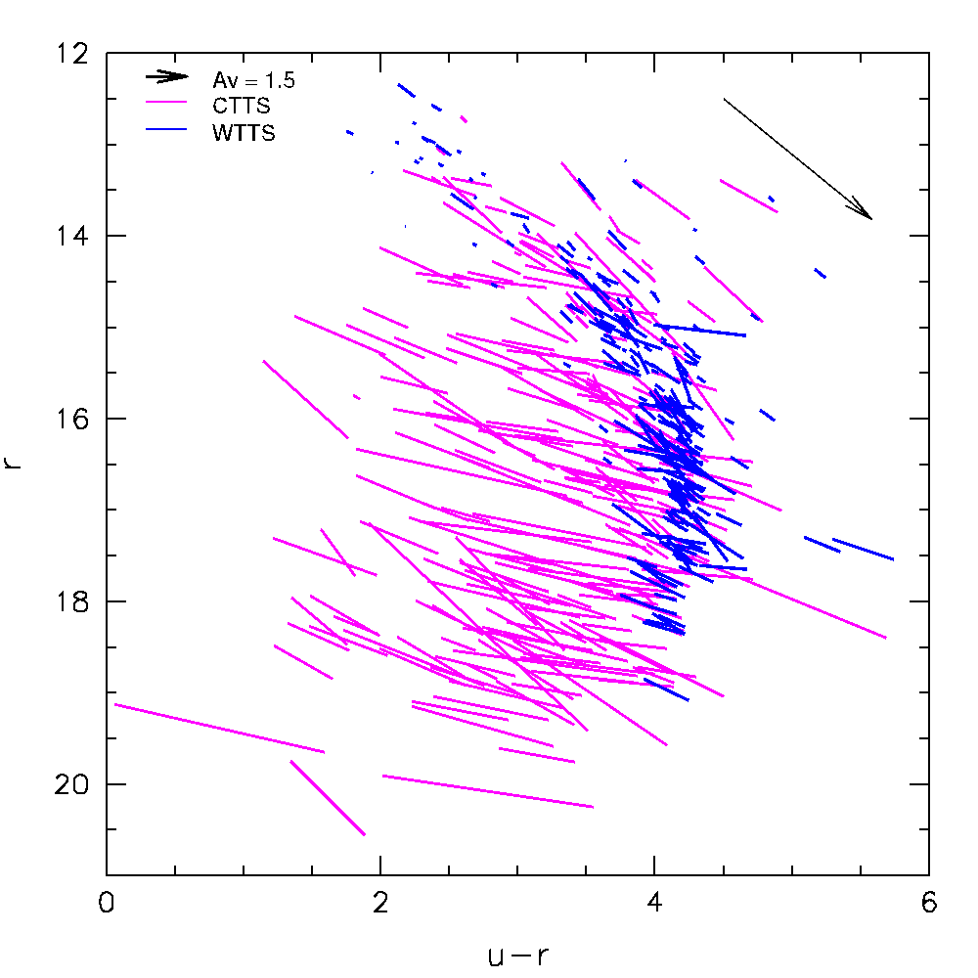
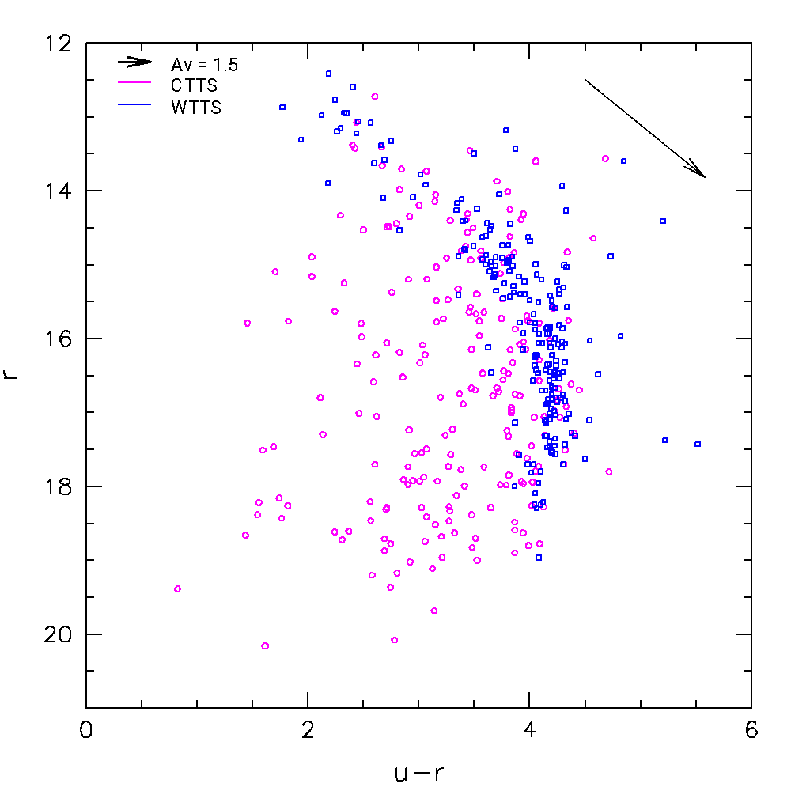

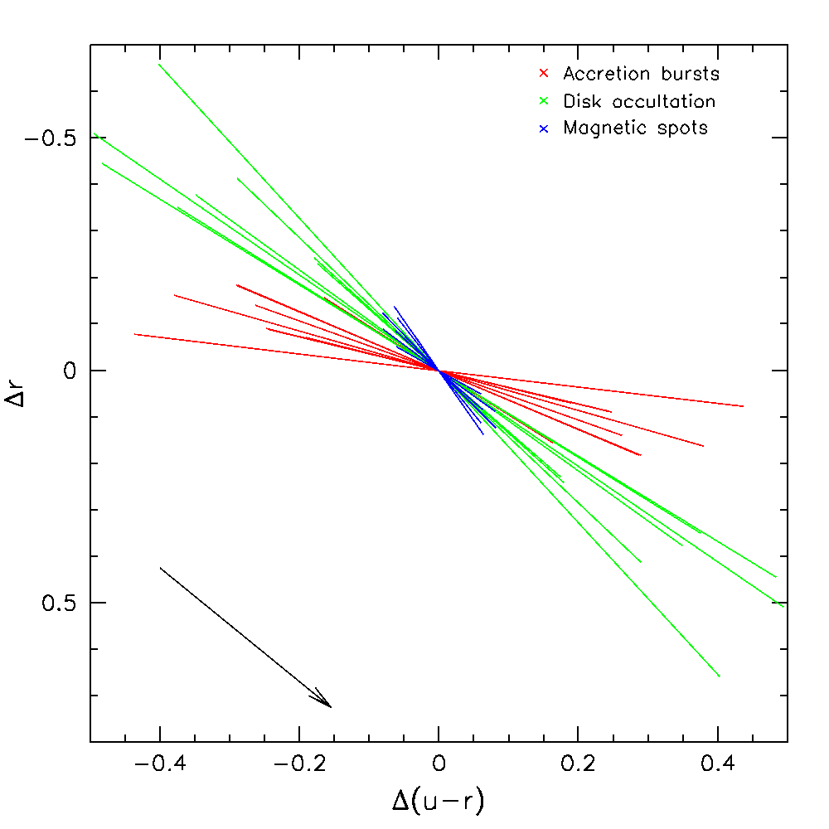
The color variability of young stars
As the measured stellar luminosity varies, individual stars move on color-magnitude diagrams
The slope of the variability vector on the diagram is indicative of the physical drivers of variability (tracer of the wavelength dependence of variability):
Accreting
Non-accreting
Burster
Dipper
Periodic
Bursters -> strong color variations in u
Periodic -> moderate color amplitudes
Dipper -> large color amplitudes and slope consistent with circumstellar extinction
Venuti et al. (2015), A&A 581, A66

Slide 14
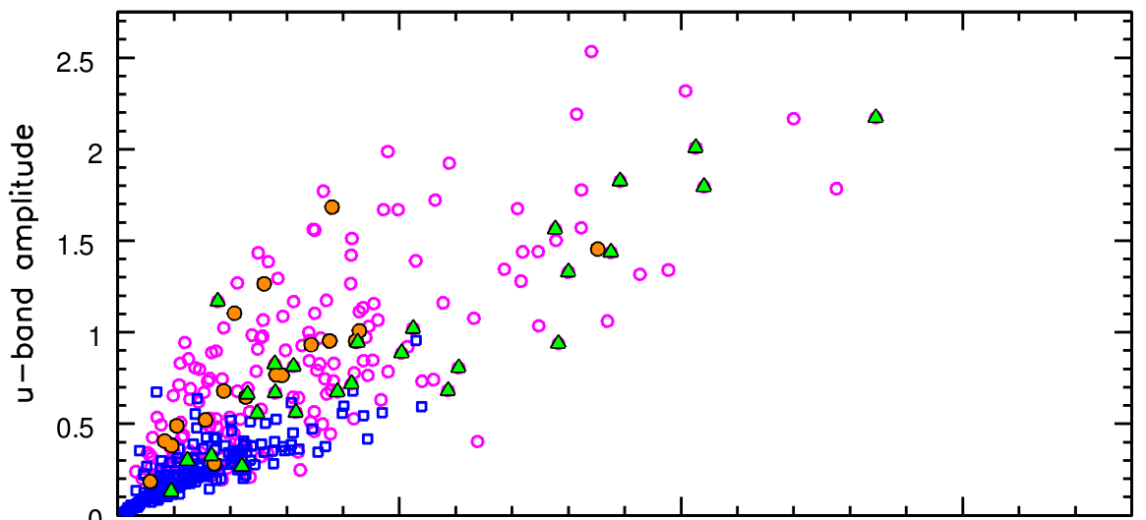
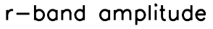
The nature of YSO variability
Venuti et al. 2015, A&A 581, A66
Typical amplitudes (mag):
- r: 0.26 for accreting YSOs, 0.11 for non-accreting YSOs
- u: 0.73 for accreting YSOs, 0.21 for non-accreting YSOs
Overlap of WTTS and CTTS loci

Slide 15
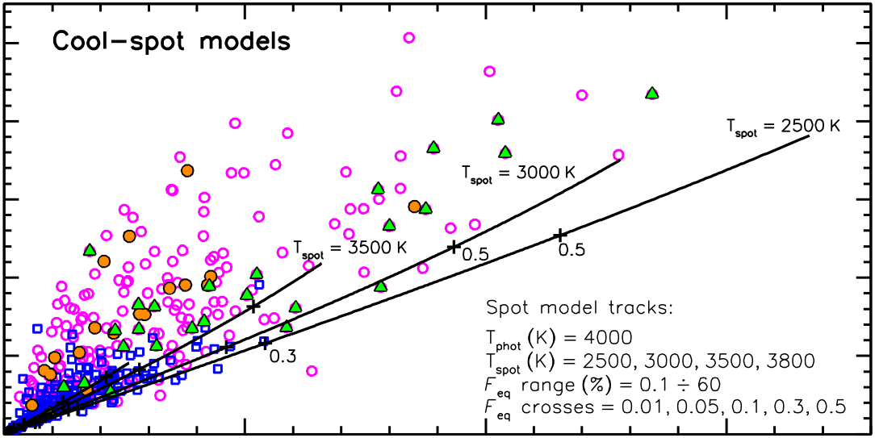
The nature of YSO variability
Venuti et al. 2015, A&A 581, A66
(formulation from Bouvier et al. 1993)
Typical amplitudes (mag):
- r: 0.26 for accreting YSOs, 0.11 for non-accreting YSOs
- u: 0.73 for accreting YSOs, 0.21 for non-accreting YSOs
Overlap of WTTS and CTTS loci
Cold spots reproduce variability for non-accreting YSOs:
- typical ΔT ≈ 500 K and F_{eq} ≈ 20%

Slide 16
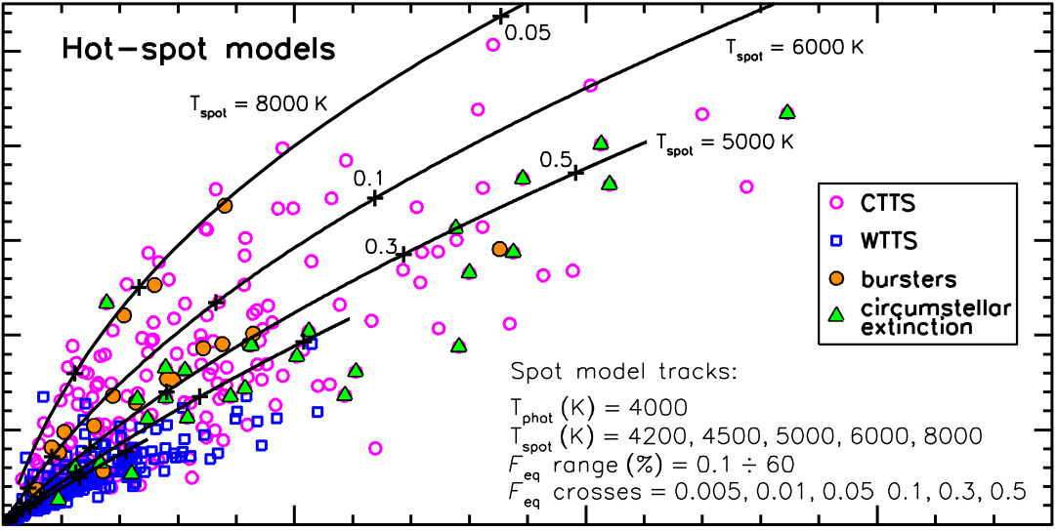
The nature of YSO variability
Venuti et al. 2015, A&A 581, A66
(formulation from Bouvier et al. 1993)
Typical amplitudes (mag):
- r: 0.26 for accreting YSOs, 0.11 for non-accreting YSOs
- u: 0.73 for accreting YSOs, 0.21 for non-accreting YSOs
Overlap of WTTS and CTTS loci
Cold spots reproduce variability for non-accreting YSOs:
- typical ΔT ≈ 500 K and F_{eq} ≈ 20%
Accreting YSOs are better described by hot spots:
- typical ΔT ≈ -1000÷2000 K and F_{eq} ≤ 5%

Slide 17
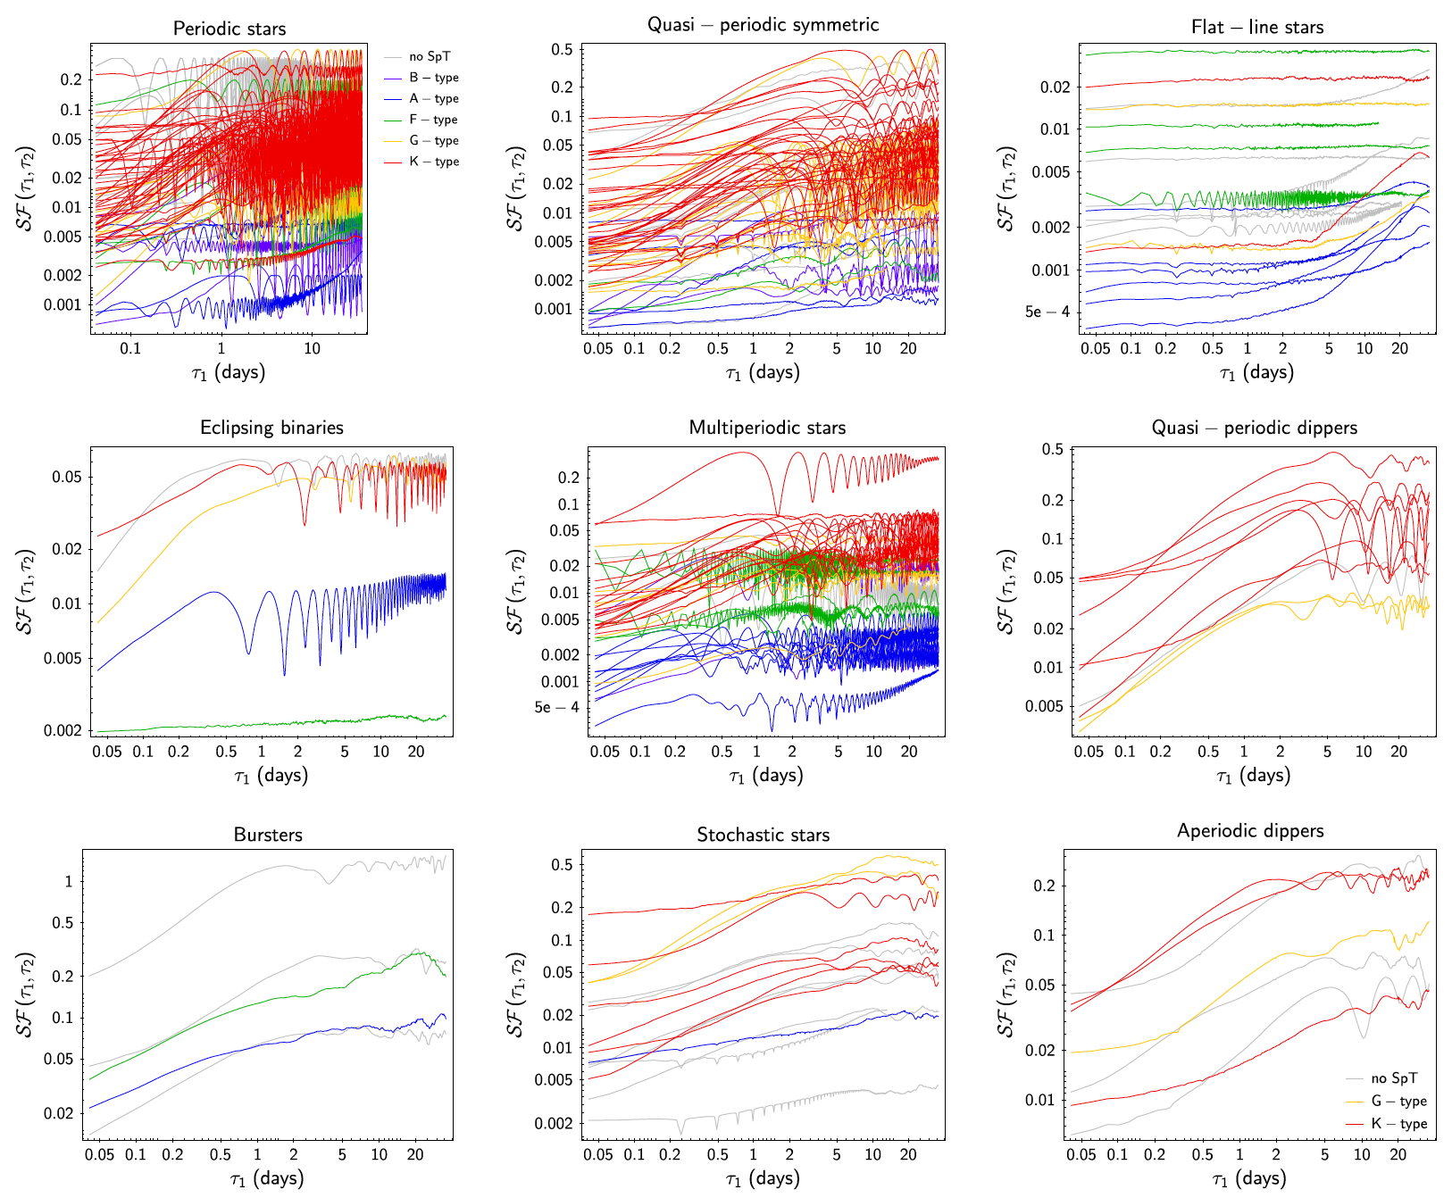

Timescales of variability for young stars
Structure function (SF) analysis:
[Sergison et al. 2020, MNRAS 491]
extract each time lag τ contained in the time series;
measure the average luminosity variation among all pairs of points in the time series separated by τ.
(P)
(QPS)
(MP)
(QPD)
At short τ, SF is dominated by noise
Over the main variability regime, SF increases with τ until the largest timescale of intrinsic variability
At longer τ, the variability observed is a reflection of intrinsic variability on shorter timescales
(B)
(S)
(APD)
Venuti et al. 2021, AJ 162, 101

Slide 18

Timescales of variability for young stars
(P)
(QPS)
Takeaways from SF analysis:
lower-mass stars more variable than higher-mass stars, across all variability classes
Disk-related phenomena more frequent in low-mass stars
Mass-dependent magnetic
field structure?
(MP)
(QPD)
Gregory et al. 2010
(B)
(S)
(APD)
Venuti et al. 2021, AJ 162, 101

Slide 19

Timescales of variability for young stars
(P)
(QPS)
(MP)
(QPD)
Processes across the inner disk exhibit no large-scale variations for 10s to 100s of rotational cycles
(B)
(S)
(APD)
Venuti et al. 2021, AJ 162, 101

Slide 20



Timescales of variability in young stars
Adapted from Costigan et al. (2014), MNRAS 440
Venuti et al. 2014 (UV excess)
Venuti et al. (2014), A&A 570, A82
(Hα EW)
(Hα)
2-week variability
(Ca II)
(Hα EW)
10-year variability of NGC 2264 members
Accretion pattern globally stable on a timescale of years, although with more erratic behavior on the short term (discrete accretion events) [Grankin et al. 2007, A&A 461, 183; Venuti et al. 2015, A&A 581, A66]
Individual objects can however switch between stable and unstable accretion or vice versa within timescales of years [Sousa et al. 2016, A&A 586, A47]

Slide 21


